Slide 1


Managerial Duties and Managerial Biases
Ulrike Malmendier, Vincenzo Pezone, and Hui Zheng
Management Science | 2022

Slide 2
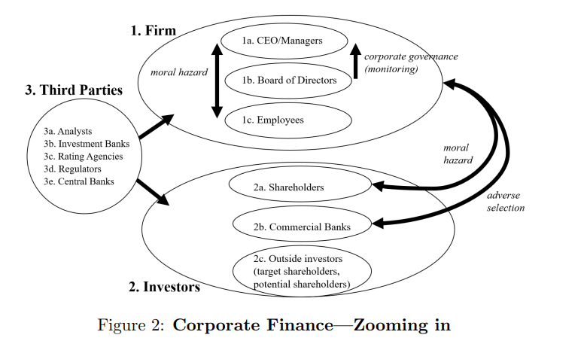
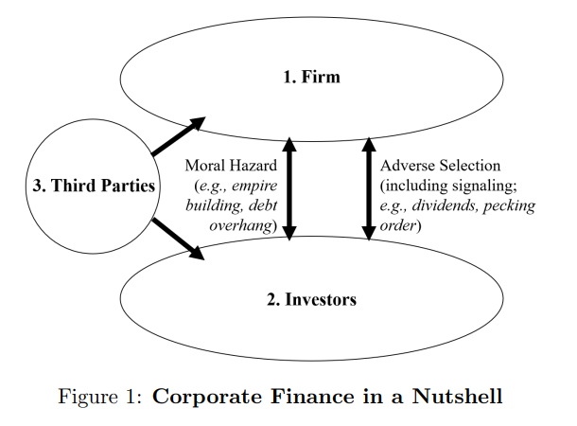
(Stereo-)typical Research
WSU
Literature
“Corporate Finance” seems a misnomer anymore
Figure 1 illustrates the types of interactions analyzed in traditional Corporate Finance
Figure 1 also indicates potential interactions with third parties, which may affect financing opportunities and choices
Figure 2 shows third parties’ impact on firm behavior
Figure 2 also demonstrates moral hazard issues within the firm
*Malmendier, 2018

Slide 3
Biased Managers
WSU
Literature
Not, biased investors.
“There is still one limitation to this existing research (Corporate Finance): Much of it focuses exclusively on the traits and biases of the chief executive officer (CEO).”
This paper demonstrates the importance of accounting for managers other than the CEO when assessing the influence of managerial biases on corporate outcomes
In doing so, the authors avoid the risk of misattribution and drawing the wrong conclusions about optimal policies
Such misattribution is particularly likely under assertive matching of managers who share similar beliefs
The authors show this in the context of managerial overconfidence, in which they evaluate the influence of the CFO (primarily) and other C-suite executives (secondarily)

Slide 4
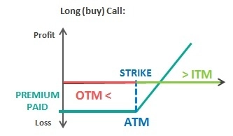
Longholder Measure
WSU
Malmendier and Tate (2005)
Longholder classifies CEOs as overconfident when they hold vested options that are at least 40% in the money in the year the options expire.
Logic:
Risk-averse CEOs would exercise deep in-the-money options well before expiration to reduce their exposure to firm-specific risks
This also lets CEOs obtain the benefits of diversification
Leaving such options outstanding signals overconfidence about the prospects of their firms

Slide 5

Longholder Measure
WSU
Malmendier and Tate (2005)
Might Longholder capture other traits?
Logic:
CEOs deemed overconfident by the Longholder measure may also tend to have lower general ability (Kaplan et al., 2022)
Lower ability might cause a CEO to be unable to figure out when it is optimal to exercise options (mistakenly holding on to them for longer than is opportune)
The Longholder measure may also capture a rational response to governance constraints on executive compensation:
Risk-neutral CEOs may take advantage of tax deferral in options
CEOs can hedge the value of their equity holdings rather than the outright sale of shares
CEOs may not be able to exercise options because the board precludes it
CEOs may believe or know the company stock is undervalued

Slide 6
Empirical Support
WSU
Initial Construction
The Model
Authors very closely follow the standard textbook treatment of Tirole (2006)
The only modification relative to prior work is the consideration of more than one manager
Likewise, authors assign capital-structure decisions to the CFO and investment/implementation decisions remain with the CEO
The Data
All data for construction of the Longholder measure of CEOs, CFOs and other executives comes from the Thomson Insider Filing database
The data was aggregated into two datasets (stock transactions and derivative transactions)
Worth noting, the Longholder measure is constructed as a permanent characteristic (pre-1996 works)
Other firm-level and tenure information are aggregated from Compustat/ExecuComp and CRSP

Slide 7
CFOs Prefer Debt
WSU
Prediction 1
Are firms more likely to issues debt than equity with overconfident managers?
At first, like prior literature, firm size seems to be the largest impact on debt issues (easier access to bank loans?) – this is insignificant
Then, replacing CEO with CFO, the CFO overconfidence effect is large and significant
The odds of debt issues are 48% higher for overconfident than for rational CFOs
The standard “financing deficit framework” (Shyam-Sunder & Myers, 1999)
Again, the coefficients of CEO overconfidence are generally positive but insignificant
Replacing CEO with CFO again, the sensitivity of net debt issues to the net financing deficit increases substantially
CFO biases exert a significant influence on firms’ financing decisions – tilted toward debt
Is manager influence strong enough to affect the “resulting capital structure?”
Are these companies, by consequence, more highly leveraged?
Including CEO Longholder only on leverage, estimates are qualitatively similar to prior research
Turning to CFO, authors estimate a strong and sizeable positive association with market leverage

Slide 8
CEOs Indirect Influence
WSU
Prediction 2
Overconfidence can lower the cost of financing: the CEO’s optimistic beliefs about returns to effort induce higher effort.
Focusing on corporate investment:
While evidence suggests that overconfident CEOs may engage in “value-destroying” projects (Malmendier et al., 2011)
Theory also suggest that overconfidence can lead to a lower cost of debt
Authors find that CFO overconfidence does not significantly influence the cost of financing, whereas that of the CEO does
The CFO, while involved, is less relevant
Considering the propensity to engage in M&A:
A natural outcome to consider, CEOs’ propensity to engage in acquisitions
CEOs tend to overestimate the additional value they create when merging (positive)
They are reluctant to use external financing (negative)
Following the trend of prior empirical work, results confirm CEO and M&A relationship
This also mitigates concerns that the CFO measure trumps CEO

Slide 9
Overconfidence in Hiring
WSU
Prediction 3
“The CEO does not necessarily select other top executives single-handedly, but is able to influence the board in the selection of a CFO who will not systematically oppose the CEO’s own vision (Landier et al., 2013) and can strongly affect the overall composition of the board (Shivdasani and Yermack, 1999).”
Authors estimate three empirical models (year fixed effects, industry fixed effects, and firm-level controls)
All three models show that overconfident CEOs are more likely to appoint overconfident CFOs
In the most demanding model, estimates imply that, in a firm run by an overconfident CEO, the likelihood of hiring an overconfident CFO rises by 29%
An interesting expansion of this research may include what other characteristics/relationships these individuals have in common? (AFA, USC Marshall – Facebook Relationships)

Slide 10
The Bright Side
WSU
Overconfidence as a Plus
“The overconfidence research… tends to leave out the potential ‘bright side’ of overconfidence.” (Malamdier, 2018)
Most obviously, overconfidence can counteract individual risk aversion (not desirable from the perspective of shareholders)
When a manager is risk-averse, overconfidence can induce him/her to take on risky, value-creating projects (that a rational manager may not)
Hirshleifer, Low and Teoh (2012) present evidence that overconfidence can spur R&D activities
Campbell et al. (2011) argue that some level of overconfidence can lead to value-maximizing policies – they find that mildly overconfident CEOs have a lower probability of being removed from the “top of the corporate ladder by the board”

Slide 11



Conclusions
WSU
“A key question in the analysis of managerial biases and the assessment of their empirical relevance is how to account for the beliefs and choices of other managers with whom a biased manager interacts.”
Authors show that CFOs’ overoptimistic beliefs have significant predictive power in explaining financing decisions (where CEO overconfidence predicts investment costs and acquisitions)
Two Promising Avenues for Future Research:
Further exploration of the traits of other (C-suite) managers.
Further research on interactions and peer effects among managers’ influence on effort and hiring

